Slide 1
Searching for Systematics in the Cosmic Microwave Background with Simulation-Based Inference
Jay Vasireddy

Slide 2
Structure of this presentation
Background/Motivation
What is SBI – 2 slides?
What is a systematic, examples in the CMB?
Our aim/method: adapt null tests to assess sensitivity to bias. Done by splitting dataset, injecting systematic and comparing posteriors
A list of tests from CMB papers, contours form SBI method, how to transfer – connect the two together
Introduce my method, and how I aim to solve it (bridging gap between cmb techniques and sbi problems)
SBI Pipeline (short, 1 slide?)
KL Divergence explanation
2D Gaussian example:
Test 1: shifting means/variance (represents measuring same thing with different instruments), show results, sensitivity
Test 2: adding correlation, show results
Lotka-Voltera:
Test: adding different noise to each split. Interesting thing to show is how KL varies depending on how data is split (vs iid Normals)
CAMB Case:
Can mention use of score compression/any specific changes to pipeline
Need more here (pipeline only now working)
Tuesday at 2pm: practice, get at least everything up till cmb done

Slide 3
Background/Motivation – What is SBI?
Cosmological datasets are complicated
Traditional Bayesian inference is often not possible
Simulation-Based Inference

Slide 4
Background/Motivation – What is a systematic bias?
Systematic bias: e.g. consistent shift in something due to something (measurement error/faulty equipment)
CMB examples:
Beam miscalibration
Pointing errors
Correlated noise
Other stuff

Slide 5
Background/Motivation – Our Aims
Adapt null tests to assess sensitivity to bias. Done by splitting dataset, injecting systematic and comparing posteriors
How are we comparing psoteriors: KL divergence

Slide 6
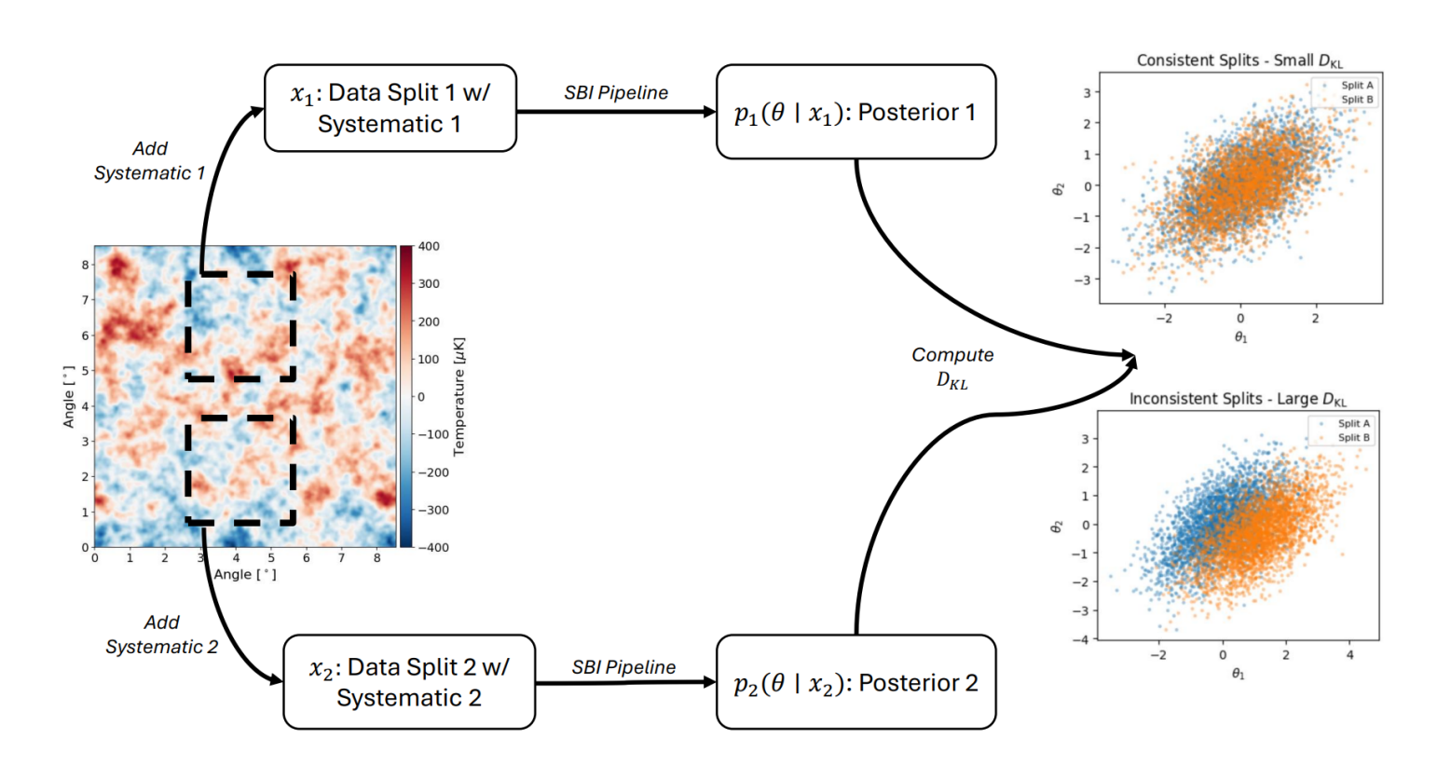
Method

